Slide 1
CSE 564 – Final Project Proposal San Francisco Incident Report Dashboard
By
Sai Vikas Balabadhrapatruni (114777850)
Chirumamilla Swati Sree (114778895)

Slide 2
Problem statement & Motivation
Assume a situation where a person along with his family is moving to San Francisco, and wanted to see how safe are the area’s near by his place. So, that he and his family stay safe.
We got motivated with this problem statement because every individual in our current world feel that there are thousands of crimes happening every minute and most people think they aren’t safe anymore. So, by solving this problem statement every individual can get to know how safe they are.
The key problem is to find the crimes for a given area in San Francisco, what kind of crimes often happen in an area, and what kind of crimes are more active for each police district.
By getting all solutions to the above mentioned problems a person can make decision is he safe at a given place in San Francisco.

Slide 3
Project Proposal
The project is on Incident report in San Francisco from 2018 till 2022.
The main idea behind the project is to finding the crimes & types of crimes occur for selected region of San Francisco.
The key behind the dashboard is a user can be able to track the crimes happened in San Francisco for a selected year or location or incident type.
The user also can see the number of active, arrest or unfounded cases for each police district for a year, location or incident type.
So, by using the visualization from the dashboard, each individual can see how safe each place in San Francisco is based on number of crimes, and what kind of crimes often occur for a given area.

Slide 4
Implementation steps
Data Extraction from online sources
Data Fusing
Data Pre-processing
Visualize the plots using D3
Building insights from the Visualization

Slide 5
Types of plots
We are planning to use 5 types of plots for visualizing the data to answer all the possible questions. Below are the 5 plots.
Geo-Map :- Map of San Francisco with indicating places all the places using dots where incident occurred.
Multi-line plot :- Multiple Line plot which indicates incident status for each police district
Pie chart :- Pie Chart indicating number of crimes for each year
Parallel Coordinate Plot :- PCP projects the correlation factors impacting majority of the incidents.
Horizontal bar chart :-Bar Chart showing number of incidents reported for a particular incident category like Murder, theft, and many more.

Slide 6
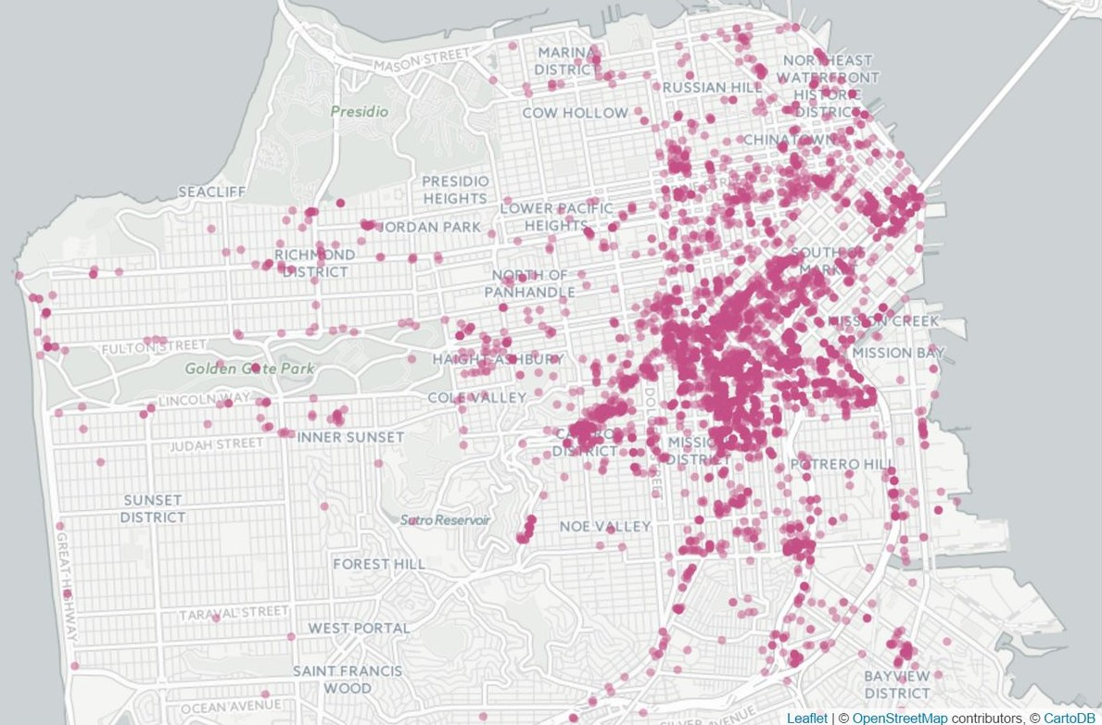
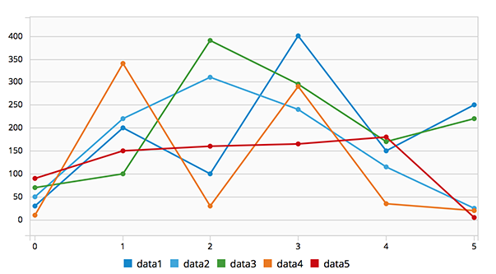
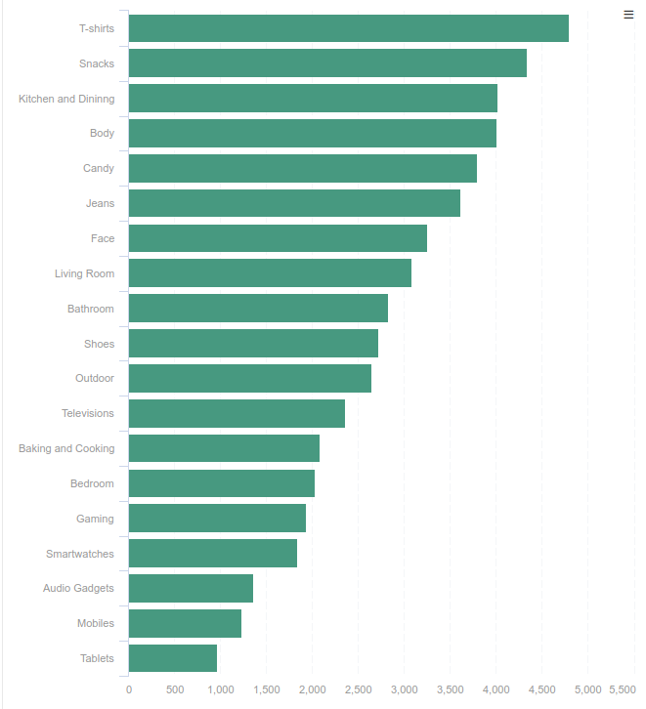
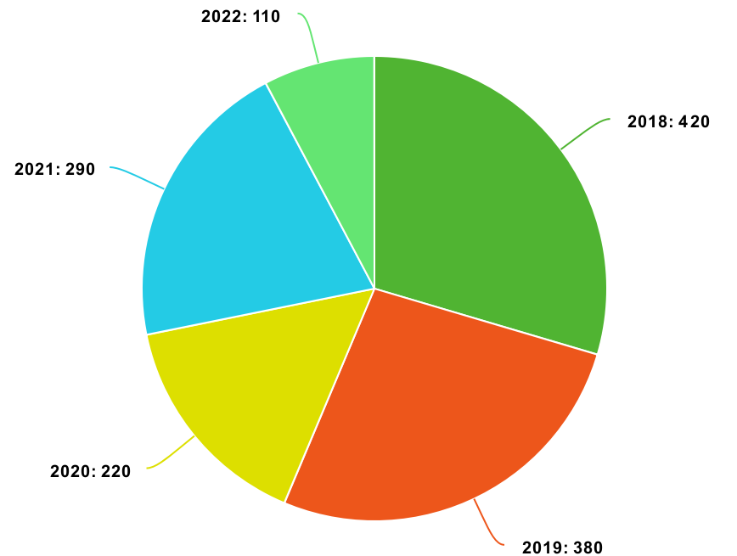
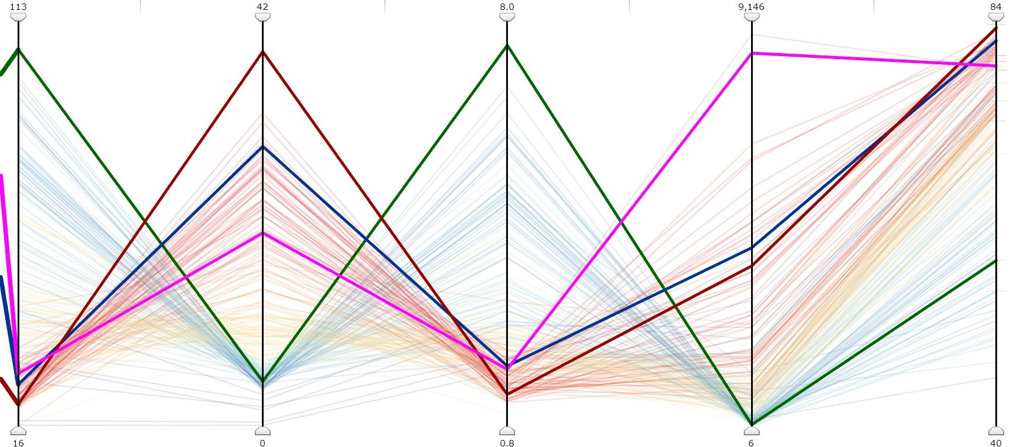
Sample Dashboard Layout
San Francisco Map
Police District vs incident status
No. Of Incidents vs Incident category
Pie chart of number of crimes per year
PCP plot for all interlinking attributes for a crime
All the images are taken from google to provide the sample layout of the Dashboard

Slide 7
Milestones
Week-1
Data Extraction
Data Fusing
Week-2,3
Data pre-processing
Visualizing the Data using D3
Week-4
Building the insights through the dashboards

Slide 8
References
Key Source File:- https://www.kaggle.com/datasets/vivovinco/san-francisco-incident-reports-2018present
D3 reference:- https://d3-graph-gallery.com/

